Slide 1



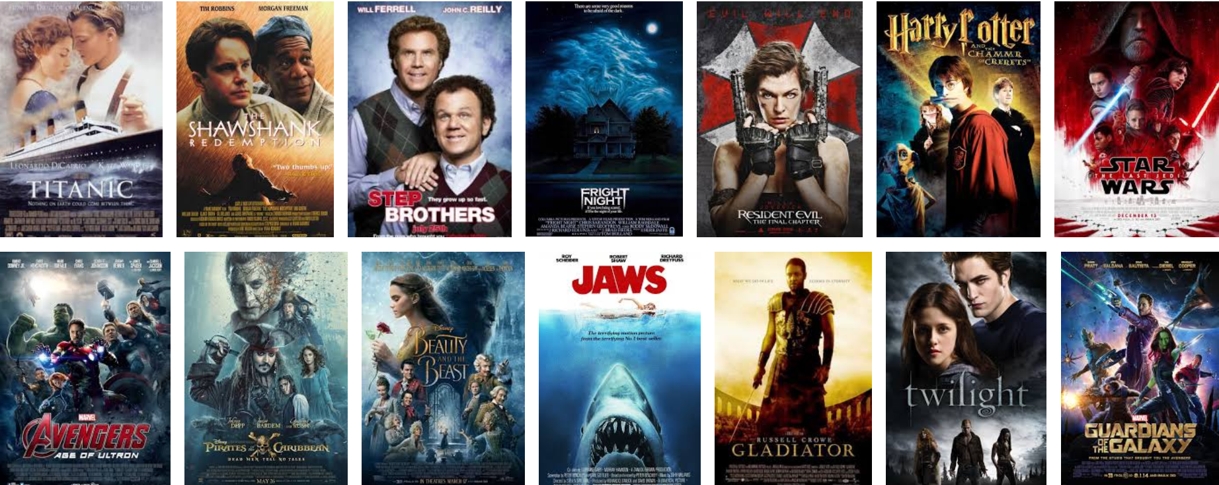
Sign in
Register
Filmstation
Genre
Load more

Slide 2
Sign in
Register
Filmstation
Genre
Action
Comedy
Horror
Indie
Racing
Sport
Load more

Slide 3
Sign in
Register
Filmstation
Username:
?
Password:
?
Login

Slide 4
Sign in
Register
Filmstation
Forgot username
Username:
?
Password:
?
Login
Reset password

Slide 5
Your Account
Your Films
Account Settings
About
Filmstation
Genre
Load more

Slide 6
Filmstation
Add Film
Film Name
Film Length
Release Date
Age Rating
Film Rating
Add
Back
You are logged in as: <Admin>

Slide 7
List Films
Filmstation
Film No
Title
Genre
Ratings
Release Date
Company Credits
Date Added
Back
You are logged in as: <Staff> <Admin>

Slide 8
Filmstation
Add Director
Director Name
Date Of Birth
Place Of Birth
Award Count
Add
Back
You are logged in as: <Admin>

Slide 9
List Directors
Filmstation
Director Name
John Erick Dowdle
Back
You are logged in as: <Staff> <Admin>

Slide 10
Filmstation
Add Actor
Actor Name
Date Of Birth
Place Of Birth
Award Count
Add
Back
You are logged in as: <Admin>

Slide 11
List Actors
Filmstation
Director Name
Eddie Murphy
Back
You are logged in as: <Staff> <Admin>

